Slide 1
Outlier Detection for High-Dimensional Neuroimaging Data
Myriam Lizotte
McGill University
Dept. Mathematics & Statistics

Slide 2
Outline
Background
Overview of outlier detection
Challenges in high-dimension
Presentation of a ML method for outlier detection in high-dimension
Application to neuroimaging data

Slide 3
Neuroimaging Data
Magnetic Resonance Imaging (MRI) is a very common brain imaging technique
We have access to ABIDE (Autism Brain Imaging Data Exchange), a large dataset of MRI data
Aggregated from different institutions to increase sample size

Slide 4
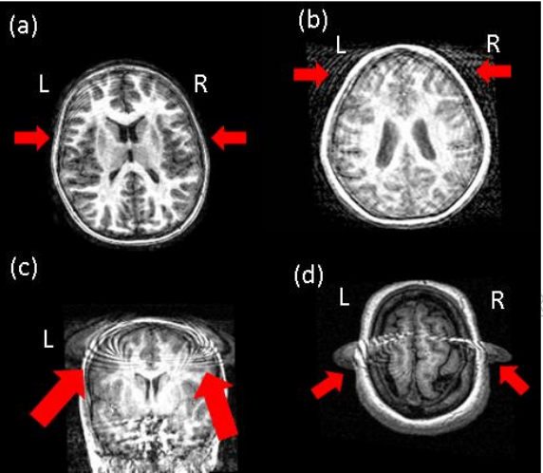
Errors in MRI Scans
In MRI scans, there can be errors in measurement or preprocessing:
Mejia, Nebel, Eloyan, Caffo, & Lindquist, 2017
Notes:
These images are outliers

Slide 5
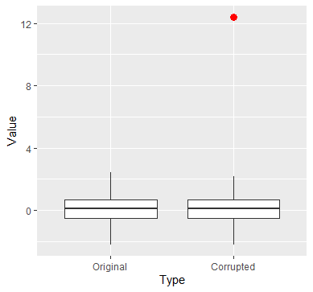
Impact of Outliers
Notes:
Toy example:
100 observations from the standard normal distribution
One observation is corrupted (by adding 10 to the maximum)

Slide 6
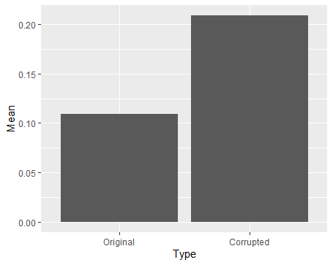
Impact of Outliers
Notes:
Toy example:
100 observations from the standard normal distribution
One observation is corrupted (by adding 10 to the maximum)
The second plot shows how the mean is affected by a single outlier

Slide 7
Challenge in High Dimension
Identifying outliers in neuroimaging data is challenging. Why?
High-dimensional: number of variables > sample size
Very hard to visualize outliers
Standard methods are computationally expensive or unusable

Slide 8
High-Dimensional Data in Other Fields
Other fields have high-dimensional data and have the same challenge:
Genetics
Medical imaging
Fraud detection
Cybersecurity

Slide 9
Outline
Background
Overview of outlier detection
Challenges in high-dimension
Presentation of a ML method for outlier detection in high-dimension
Application to neuroimaging data
Notes:
To put you in context:
Our lab has developped a statistical method to detect outliers in high dimensions based on expectiles.
Tried on ABIDE data too.
But because other methods were developped in ML literature
We thought it would be interesting to see how they compare.
That’s why I’m presenting this method

Slide 10
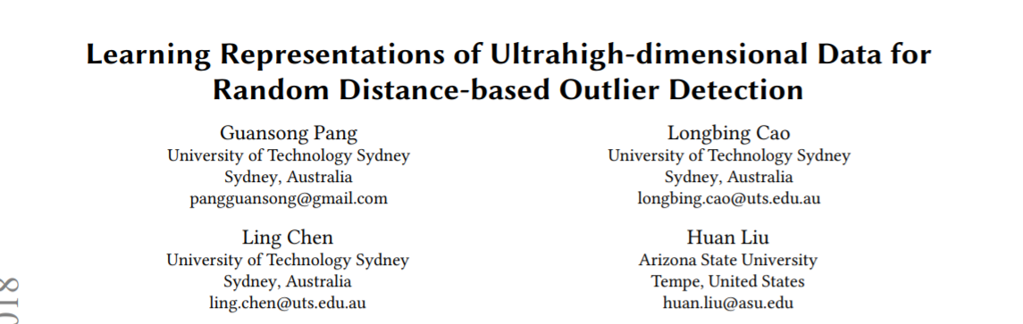
RAMODO Method
Notes:
In more details:
Learns to reduce dimensions in a way that after reducing dimension, we can apply distance-based outlier detection
A point that was an outlier in the original (high-dimensional space) will still be detected as an outlier in the lower-dimensional space

Slide 11
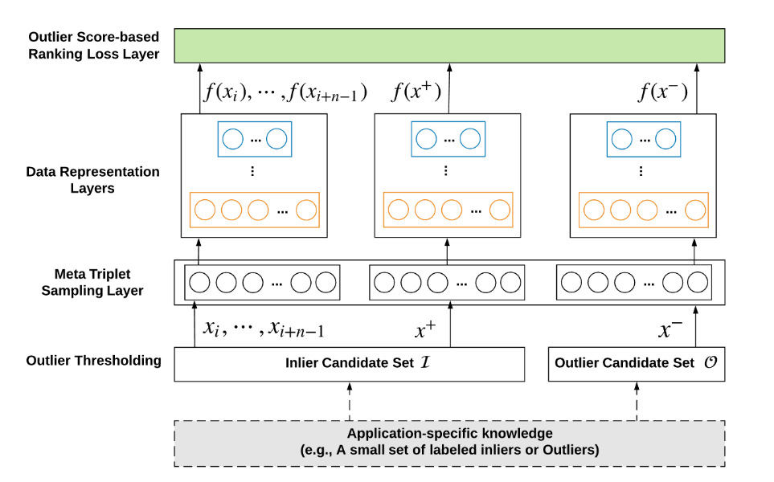
Method
Notes:
4 steps starting from the bottom
Let’s zoom in

Slide 12

Triplet Generation
Notes:
First step: divide into potential inliers and outliers
How?
Score for each x
This uses the formula below
Second step: sample triplets

Slide 13




Loss Function
$$Q$$
$$f(x^{−})$$
Goal is to learn a representation function f satisfying
$$nn_dist ( f(x^{+})|Q) < nn_dist ( f(x^{−})|Q)$$
$$f(x^{+})$$

Slide 14
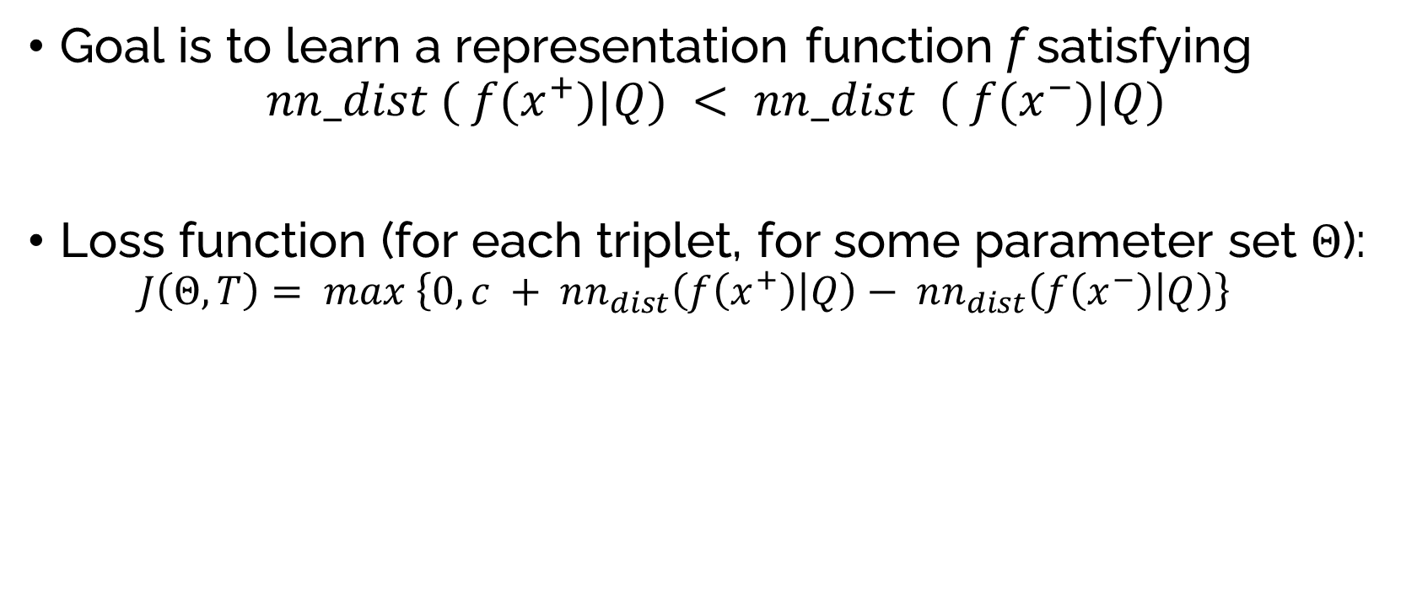
Loss Function
$$Q$$
$$f(x^{−})$$
Goal is to learn a representation function f satisfying
$$nn_dist ( f(x^{+})|Q) < nn_dist ( f(x^{−})|Q)$$
Loss function (for each triplet, for some parameter set $Θ$):
$$J\left(Θ, T\right)= max \left\{0, c + nn_{dist}\left(f\left(x^{+}\right) | Q\right)− nn_{dist}\left(f\left(x^{−}\right) | Q\right)\right\}$$
$$f(x^{+})$$
Notes:
J is 0 unless nn_dist(f(x+) - nn_dist(f(x-) + c > 0
Iff nn_dist(f(x+)) + c > nn_dist(f(x-))
We want the difference to be negative and larger in absolute value than c
Constant c encourages distance between inliers and outliers

Slide 15
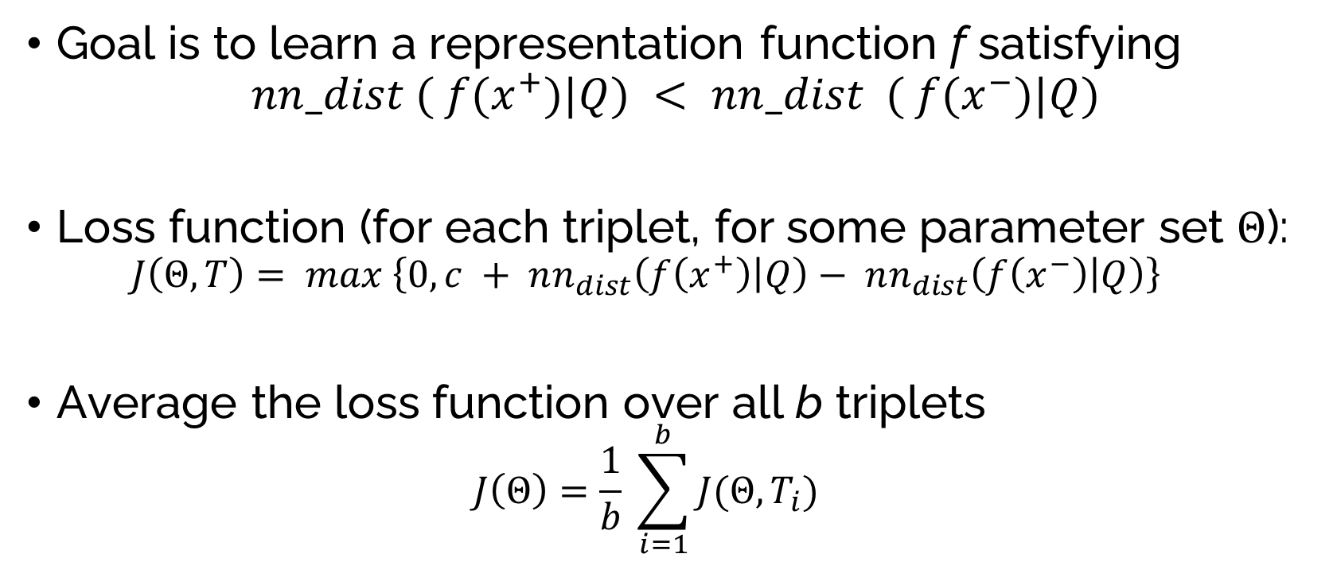
Loss Function
$$Q$$
$$f(x^{−})$$
Goal is to learn a representation function f satisfying
$$nn_dist ( f(x^{+})|Q) < nn_dist ( f(x^{−})|Q)$$
Loss function (for each triplet, for some parameter set $Θ$):
$$J\left(Θ, T\right)= max \left\{0, c + nn_{dist}\left(f\left(x^{+}\right) | Q\right)− nn_{dist}\left(f\left(x^{−}\right) | Q\right)\right\}$$
Average the loss function over all b triplets
$$J\left(Θ\right)=\frac{1}{b} \sum_{i=1}^{b}{J(Θ, T_{i})}$$
$$f(x^{+})$$

Slide 16
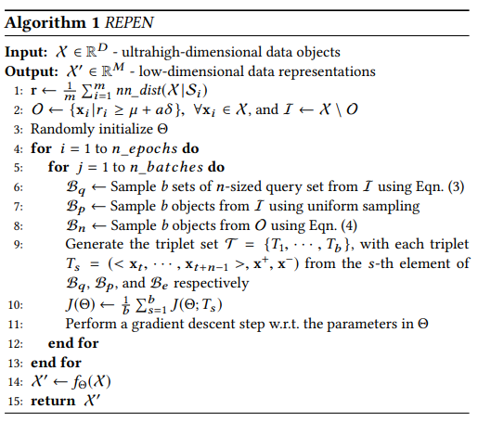
Algorithm
Notes:
Outlier treshholding
Make 2 sets (potential inliers and outliers)
Sample b triplets
b query sets Q
b inlier examples x⁺
b outlier examples x⁻
Apply the function f to all triplets
with current parameters (initially random)
Calculate the loss function
Gradient descent with respect to the parameters
Repeat

Slide 17
Outlier Scoring
After reducing dimensions, we find an outlier score for each data point:

Slide 18
Application
We applied the method (RAMODO) to three different datasets:
AID362 | Bioassay of active/inactive compounds 4279 by 114 1,4 % of outliers
Census | Demographic & salary information 299,285 by 500 6,2% of outliers
ABIDE | Cortical thickness measures from MRI 542 by 149 956
Notes:
AID
contained labelled outliers
outliers are the active compounds (those able to bind with target)
Formylpeptide Receptor Ligand Binding
not sure what the columns are
examples of columns: NEG_07_NEG_binarized, HBA_07_ARC_binarized
Census
examples of columns: type of employment, native country, relationship status, education
outliers are salaries over 50K/year
ABIDE
Abide data is already preprocessed
Measures of cortical thickness inferred from MRI scan
The sample size, considering only the controls, is 542
columns are locations on the brain
on hemisphere only (left)

Slide 19
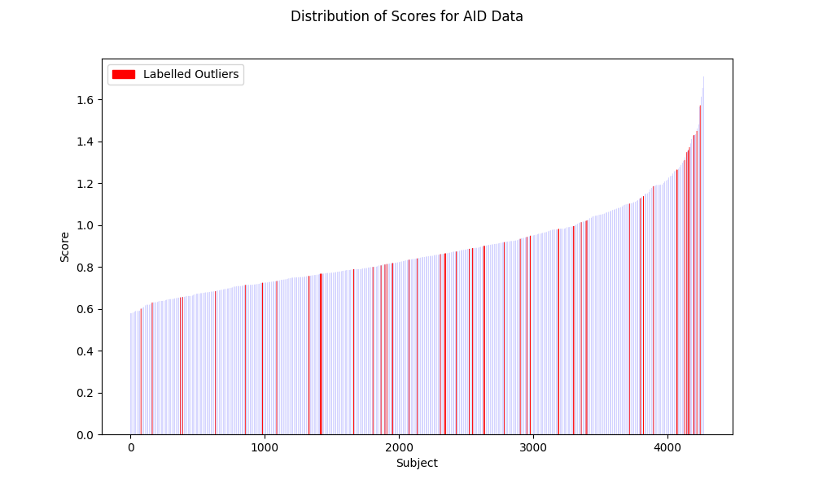
AID362
Notes:
This plot shows the scores for each subject (in increasing order)
In red are the labelled outliers
60 labelled outliers, out of >4000 points
Outliers in red

Slide 20
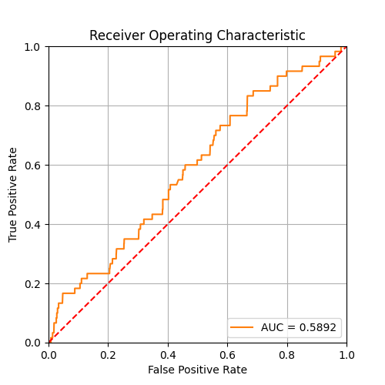
AID362
Notes:
ROC (Receiver Operating Characteristic) curve
Plotting TPR and FPR for different thresholds
Performance of classification is measured by AUC (Area Under Curve)
If I have more positives, do I have
TPR= TP/(TP+FN)
FPR = FP/(FP+TN)

Slide 21
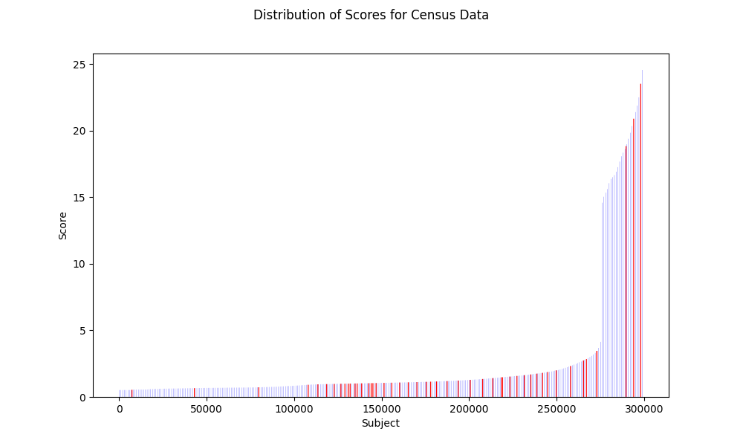
Notes:
Many more outliers than before (18568)
I’m not plotting them all, only plotting one point out of 1000 (but they’re in increasing order
Plotting one out of 500 labelled outliers

Slide 22
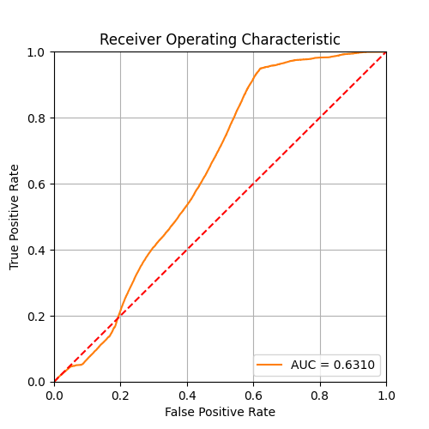
Census

Slide 23
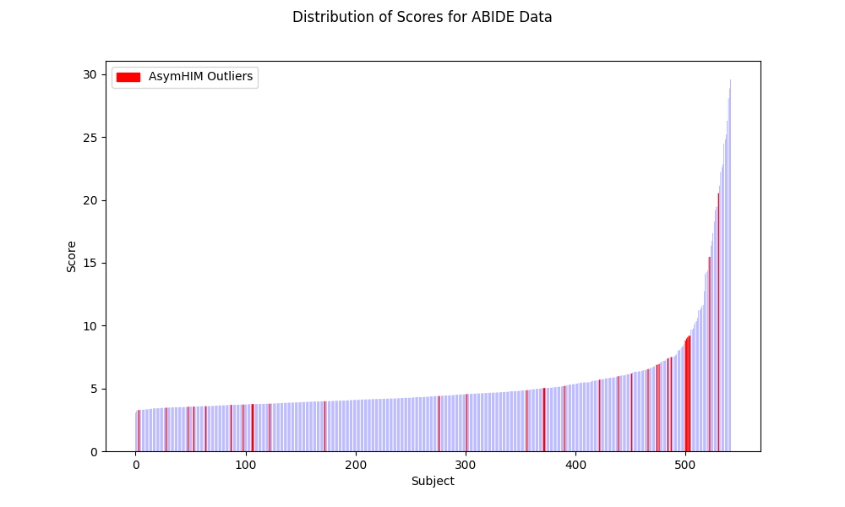
ABIDE
Notes:
In red is AsymHIM
Pourquoi j’ai pas le AUC (labelled outliers)

Slide 24
Conclusions
We presented a machine learning method to detect outliers in high-dimensional data
We applied it to the ABIDE dataset
Limitations of the method
Challenges
Notes:
Limitations of the method:
Performance depends on good preliminary outlier detection
Need to decide on a treshhold for classification at the end
To evaluate performance, we need to know in advance which are outliers
Challenges
Understanding and running code written by others
Compute Canada & dependencies & gpu

Slide 25
Acknowledgements
Many thanks to Amadou Barry & Prof. Celia Greenwood for their supervision and helpful guidance throughout my project!

Slide 26
References
S. J. Sujit, R. E. Gabr, I. Coronado, M. Robinson, S. Datta and P. A. Narayana, "Automated Image Quality Evaluation of Structural Brain Magnetic Resonance Images using Deep Convolutional Neural Networks," 2018 9th Cairo International Biomedical Engineering Conference (CIBEC), 2018, pp. 33-36, doi: 10.1109/CIBEC.2018.8641830.
Pang, G., Cao, L., Chen, L., & Liu, H. (2018). Learning Representations of Ultrahigh-dimensional Data for Random Distance-based Outlier Detection. KDD 2018: 24th ACMSIGKDD International Conference on Knowledge Discovery & Data Mining, 2041–2050.
Sugiyama, M., & Borgwardt, K. M. (2013). Rapid distance-based outlier detection via sampling. Advances in Neural Information Processing Systems, 1–9.
Schierz, A.C. Virtual screening of bioassay data. J Cheminform 1, 21 (2009). https://doi.org/10.1186/1758-2946-1-21
Kohavi, R and Becker, B. (1996). Adult Data Set. UCI Machine Learning Repository [https://archive.ics.uci.edu/ml/datasets/adult] Data Mining and Visualization, Silicon Graphics.
Di Martino, A., C.-G. Yan, Q. Li, E. Denio, F. X. Castellanos, K. Alaerts, J. S. Anderson, M. Assaf, S. Y. Bookheimer, M. Dapretto, et al. 2014. The autism brain imaging data exchange: towards a large-scale evaluation of the intrinsic brain architecture in autism. Molecular Psychiatry 19 (6):659–67. doi:10.1038/mp.2013.78.

